Slide 1
Insights: Gustafson’s Law and Amdahl’s Law
Parallel Computing – Theoretical Limits & Scaled Speedup Analysis

Slide 2
Introduction to Parallel Speedup Laws
Amdahl’s Law and Gustafson’s Law are fundamental in parallel computing.
They analyze achievable performance improvements.
They guide parallel system design decisions.
They influence hardware scaling strategies.

Slide 3
Amdahl’s Law – Definition
Maximum Speedup for Fixed Problem Size
Provides maximum theoretical speedup for a fixed workload.
Based on fraction of code that can be parallelized.
Shows diminishing returns as processors increase.
Let:
P = parallel fraction of program
N = number of processors
Speedup S(N) = 1 / [ (1 − P) + (P / N) ]

Slide 4
Amdahl’s Law – Interpretation
If serial portion is large → speedup is limited.
Even infinite processors cannot exceed limit:
S(∞) = 1 / (1 − P)
Represents upper bound of strong scaling.

Slide 5
Gustafson’s Law – Definition
Scaled Speedup with Increasing Problem Size
Assumes problem size increases with processor count.
More optimistic than Amdahl’s Law.
Focuses on weak scaling behavior.
Let:
α = serial fraction
N = number of processors
Speedup S(N) = N − α (N − 1)

Slide 6
Gustafson’s Law – Interpretation
As N increases, speedup grows nearly linearly.
Works when workload scales with hardware.
Encourages building large-scale systems.

Slide 7
Interpretation & Decision Framework
How to Deduce Meaning After Computing Amdahl & Gustafson Results

Slide 8
Fixed Problem Size Scenario
Use Amdahl’s Law.
Focus on minimizing serial portion.
Parallelization has hard upper bound.
Decision Making Insights
Scaled Problem Size Scenario
Parallelization Strategy: Fixed vs Scaled workload.
Resource Allocation: Add processors or optimize code?
Problem Reformulation: Increase parallel fraction.
Use Gustafson’s Law.
Increase workload with processors.
Higher effective speedup achievable.

Slide 9
Step 1: Identify Scaling Scenario
Step 3: Evaluate Efficiency
Fixed workload → Use Amdahl (Strong Scaling)
Growing workload → Use Gustafson (Weak Scaling)
Ask: Are we speeding up the same job or solving a bigger job?
Efficiency E(N) = S(N) / N
If E drops sharply → Adding processors is wasteful
Check marginal gain: S(2N) / S(N)
If doubling CPUs gives <10% improvement → Not cost-effective
Step 2: Compare Both Speedups
Step 5: Real-World Design Decisions
Step 4: Serial Fraction Strategy
If Amdahl << Gustafson → System benefits only if workload scales
If Both High → Good parallel fraction; scaling justified
If Both Low → Large serial bottleneck; optimize algorithm
Reducing serial fraction α improves performance more than adding CPUs
Optimization priority: Reduce synchronization, I/O, locks
Measure effective serial fraction including overhead
HPC fixed dataset → Optimize serial part (Amdahl dominates)
HPC higher resolution → Scale problem (Gustafson applies)
HTC / Cloud workloads → Ensure low coordination overhead
Cost & energy must be considered alongside speedup

Slide 10
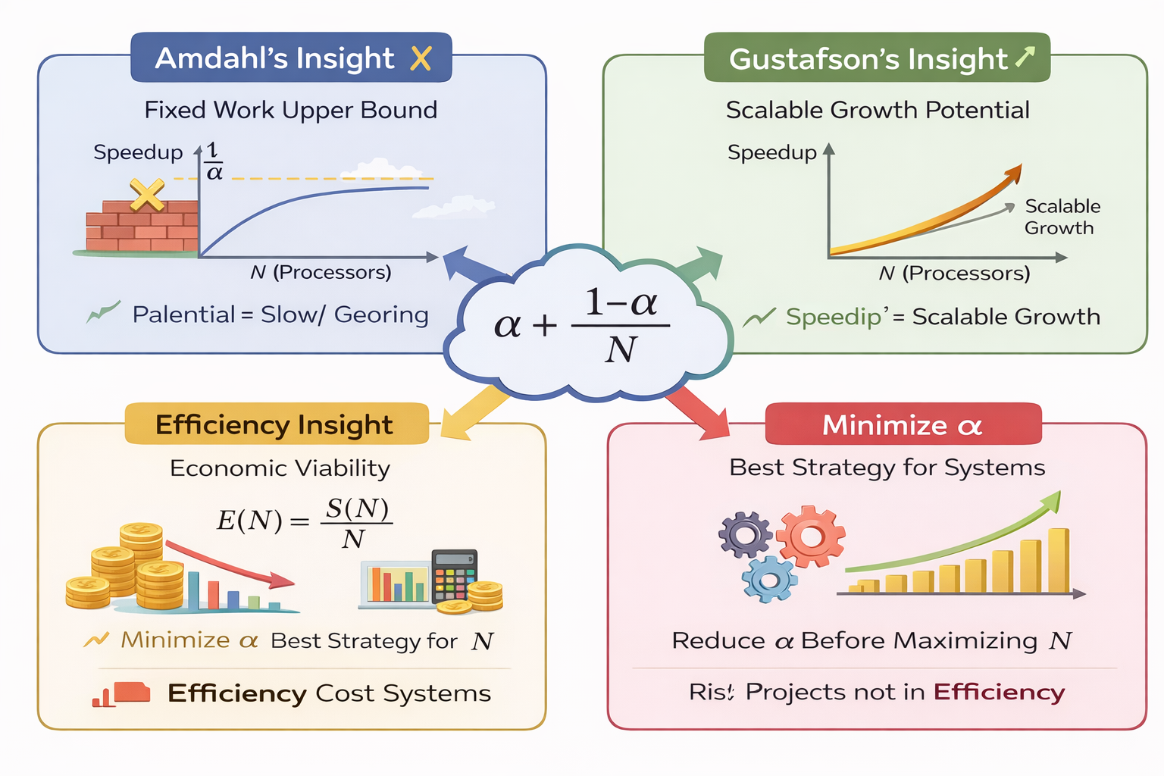
Core Variables
alpha = serial fraction P = parallel fraction N = number of processors S(N) = speedup using N processors E(N) = efficiency using N processors T1 = execution time on 1 processor TN = execution time on N processors S(infinity) = theoretical maximum speedup

Slide 11
Amdahl’s Law (Strong Scaling)
S(N) = 1 / [ alpha + (1 − alpha)/N ]
or
S(N) = 1 / [ (1 − P) + P/N ]
Maximum speedup:
S(infinity) = 1 / alpha
Efficiency:
E(N) = S(N) / N
Gustafson’s Law (Weak Scaling)
S_G(N) = N − alpha (N − 1)
Equivalent form:
S_G(N) = alpha + (1 − alpha) N
Core Variables
alpha = serial fraction P = parallel fraction N = number of processors S(N) = speedup using N processors E(N) = efficiency using N processors T1 = execution time on 1 processor TN = execution time on N processors S(infinity) = theoretical maximum speedup
Quick Interpretation Cheat Sheet
If alpha small → system scalable If E(N) drops sharply → over-parallelization If S(infinity) small → optimize serial portion If S_G(N) ≈ N → near-linear weak scaling
Relationships
P = 1 − alpha alpha = 1 − P

Slide 12
Amdahl’s Law Applications
1. Predicting speedup limits.
2. Identifying serial bottlenecks.
3. Guiding optimization of parallel algorithms.
Gustafson’s Law Applications
1. Designing scalable parallel systems.
2. Supporting large dataset processing.
3. Predicting scalability in exascale systems.

Slide 13
Real-World Applications

Slide 14
Scientific Simulations
Real-World Applications
Climate modeling
Fluid dynamics
Materials science
High-Performance Computing
Data Analytics
Supercomputers
Cloud computing platforms
Distributed computing infrastructures
Machine learning
Data mining
Big data processing

Slide 15
Numerical Example Analysis

Slide 16
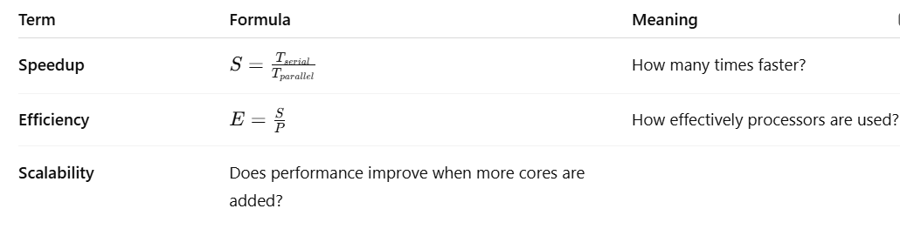
Foundation Metrics
High S, high E: algorithm scales well; overheads/serial fraction small.
High S, low E: good absolute speed but diminishing returns (likely overheads or load imbalance).
Low S even for large N: serial bottleneck dominates (increase parallel fraction or reduce sync/I/O).

Slide 17
Given Problem
Serial fraction = 20% (0.2)
Parallel fraction = 80% (0.8)
Processors N = 16
Speedup S(N) = 1 / [ (1 − P) + (P / N) ]
Speedup S(N) = N − α (N − 1)
Amdahl’s Law Calculation
Gustafson’s Law Calculation
S(16) = 1 / [0.2 + (0.8 / 16)]
S(16) = 1 / [0.2 + 0.05]
S(16) = 1 / 0.25
S(16) = 4
S(16) = 16 − 0.2(15)
S(16) = 16 − 3
S(16) = 13
Interpretation of Results
Amdahl: Fixed workload limited to 4× speedup.
Gustafson: Scaled workload achieves ~13× speedup.
Scaling context determines which law applies.

Slide 18
Scaling in Practice
What Does Scaling Mean?
Hardware Scaling
Increasing problem size (larger simulation).
Increasing dataset size (big data systems).
Increasing user load (web applications).
Adding more processors (horizontal scaling).
Using GPUs or accelerators.
Upgrading infrastructure for parallel workloads.
Important Clarification
Gustafson’s Law assumes workload scales with processors.
It is not simply adding hardware without increasing work.
True benefit occurs when computation grows with resources.

Slide 19
Numerical Exercises (with Solutions)
Amdahl’s Law • Gustafson’s Law • Efficiency • Bottlenecks • Scaling Decisions

Slide 20
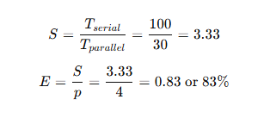
Example 1 — Basic Speedup and Efficiency
A sequential program takes 100 seconds to execute. When parallelized on 4 cores, the execution time becomes 30 seconds.
Find:
Speedup
Efficiency
Interpretation: The program runs 3.33× faster and uses 83% of the available parallel capacity efficiently.

Slide 21
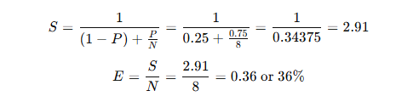
Example 2 — Amdahl’s Law Application
A program is 25% sequential and 75% parallelizable. Compute speedup on 8 processors.
Interpretation: Even with 8 processors, sequential bottlenecks limit total speedup to only 2.9×.

Slide 22
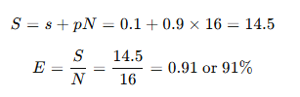
Example 3 — Gustafson’s Law (Scaled Problem Size)
If 10% of a task is sequential and 90% is parallelizable, find the speedup for 16 cores.
Interpretation: When workload scales with more cores, efficiency remains high — nearly linear scalability.

Slide 23
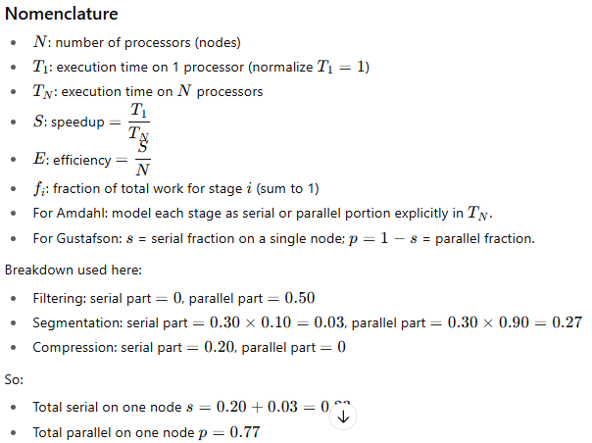
Example 4 — A parallel image processing pipeline runs on 20 worker nodes using a work-stealing scheduler. Each image tile passes through the following three stages:
Assume: The workload is perfectly balanced across all nodes (no idling). The workload scales linearly with problem size (i.e., more tiles keep all 20 nodes busy).
Using Amdahl’s Law, calculate the maximum overall speedup achievable on 20 nodes.
2. Using Gustafson’s Law, compute the projected speedup assuming the workload scales with problem size.
SOLUTION:
Parallel Image Pipeline — Speedup & Efficiency
Given (per image tile)
System: 20 worker nodes, work-stealing scheduler Assumptions: perfect load balance; linear scale with problem size; negligible scheduling overhead outside stated sync cost.
Stage | Fraction of total work | Parallelism characteristics
Filtering | 0.50 | perfectly parallelizable
Segmentation | 0.30 | 10% serial (sync), 90% parallelizable
Compression | 0.20 | fully serial (I/O ordering)

Slide 24
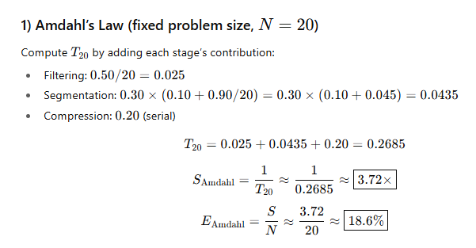
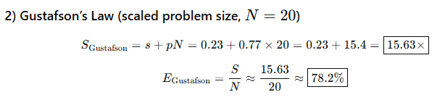
With a fixed workload, the 23% serial portion caps speedup at ~3.7× on 20 nodes.
With a scaled workload that keeps all nodes busy, projected speedup is ~15.6× with ~78% efficiency.

Slide 25
Problem 1: Amdahl Speedup
A program has parallel fraction P = 0.90 and runs on N = 12 processors.
Compute the theoretical speedup S(N) using Amdahl’s Law.
Amdahl: S(N) = 1 / [(1−P) + P/N]
S(12) = 1 / [0.10 + 0.90/12]
0.90/12 = 0.075
Denominator = 0.10 + 0.075 = 0.175
S(12) = 1 / 0.175 = 5.714

Slide 26
Problem 2: Maximum Speedup Limit
A program is 8% serial (serial fraction = 0.08).
What is the maximum possible speedup as N → ∞?
Amdahl limit: S(∞) = 1 / α
α = 0.08
S(∞) = 1 / 0.08 = 12.5

Slide 27
Problem 3: Processors Needed (Amdahl)
Parallel fraction P = 0.95. Target speedup is at least 10×.
Find the minimum integer N such that S(N) ≥ 10.
S(N) = 1 / [(1−P) + P/N]
Need 1 / [0.05 + 0.95/N] ≥ 10
So 0.05 + 0.95/N ≤ 0.1
0.95/N ≤ 0.05
N ≥ 0.95/0.05 = 19
Minimum N = 19

Slide 28
Problem 4: Parallel Efficiency
A program achieves speedup S = 18 on N = 32 processors.
Compute efficiency E.
Efficiency: E = S/N
E = 18/32 = 0.5625 = 56.25%

Slide 29
Problem 5: Runtime on N Processors (Amdahl)
Single-processor time T1 = 200 seconds.
Parallel fraction P = 0.85, N = 10.
Find Tp.
Amdahl gives speedup S(N) = 1 / [(1−P)+P/N]
S(10) = 1 / [0.15 + 0.85/10]
0.85/10 = 0.085 → denominator = 0.235
S(10) = 1/0.235 = 4.255
Tp = T1 / S = 200 / 4.255 ≈ 47.0 s

Slide 30
Problem 6: Gustafson Speedup
Serial fraction α = 0.12, N = 64 processors.
Compute scaled speedup using Gustafson’s Law.
Gustafson: S(N) = N − α(N−1)
S(64) = 64 − 0.12×63
0.12×63 = 7.56
S(64) = 64 − 7.56 = 56.44

Slide 31
Problem 7: Compare Amdahl vs Gustafson
A workload has serial fraction α = 0.05 and N = 32.
Compute: (a) Amdahl speedup, (b) Gustafson speedup.
(a) Amdahl: S = 1 / [α + (1−α)/N]
S = 1 / [0.05 + 0.95/32]
0.95/32 = 0.0296875 → denom = 0.0796875
Amdahl S ≈ 12.55
(b) Gustafson: S = N − α(N−1)
S = 32 − 0.05×31 = 32 − 1.55 = 30.45

Slide 32
Problem 8: Estimate Serial Fraction from Speedup
Measured speedup S = 6 on N = 8 processors (assume Amdahl applies).
Estimate serial fraction α.
Amdahl: S = 1 / [α + (1−α)/N]
So 1/S = α + (1−α)/N
1/6 = α + (1−α)/8
Multiply by 8: 8/6 = 8α + (1−α) = 7α + 1
8/6 − 1 = 7α
2/6 = 7α → α = (2/6)/7 = 2/42 = 0.0476 (≈ 4.76%)

Slide 33
Problem 9: Communication Overhead Impact
A program has ideal parallel fraction P = 0.92.
However, overhead adds 5% extra serial time (relative to total).
Approximate new serial fraction α' and compute Amdahl speedup for N = 16.
Original serial fraction α = 1−P = 0.08
Overhead adds 0.05 to serial fraction → α' ≈ 0.13
Parallel fraction becomes (1−α') = 0.87
Amdahl: S = 1 / [α' + (1−α')/N]
S(16) = 1 / [0.13 + 0.87/16]
0.87/16 = 0.054375 → denom = 0.184375
S ≈ 5.42

Slide 34
Problem 10: Find Serial Fraction (Gustafson)
Scaled speedup measured S = 120 on N = 128 processors (assume Gustafson).
Estimate serial fraction α.
Gustafson: S = N − α(N−1)
120 = 128 − α×127
α×127 = 128 − 120 = 8
α = 8/127 = 0.0630 (≈ 6.30%)

Slide 35
Problem 11: Diminishing Returns
Parallel fraction P = 0.98.
Compute speedup for N=50 and N=100 using Amdahl. Comment on gains.
S(50)=1/[0.02+0.98/50]=1/[0.02+0.0196]=1/0.0396=25.25
S(100)=1/[0.02+0.98/100]=1/[0.02+0.0098]=1/0.0298=33.56
Doubling processors from 50→100 increases speedup only 25.25→33.56 (limited by 2% serial).

Slide 36
Problem 12: Efficiency at Scale
For Problem 11, compute efficiency at N=50 and N=100.
E(50)=S/N=25.25/50=0.505=50.5%
E(100)=33.56/100=0.3356=33.6%
Efficiency drops as N increases due to fixed serial fraction.

Slide 37
Problem 13: When Adding CPUs Stops Helping
Parallel fraction P = 0.90.
At what N does increasing N to 2N improve speedup by less than 10%? (Use Amdahl; approximate numerically.)
We compare S(2N)/S(N) < 1.10
S(N)=1/[0.10+0.90/N]. Try N=40: S=1/[0.10+0.0225]=1/0.1225=8.163
S(80)=1/[0.10+0.01125]=1/0.11125=8.988
Ratio=8.988/8.163=1.101 (≈10.1%)
Try N=45: S=1/[0.10+0.02]=1/0.12=8.333
S(90)=1/[0.10+0.01]=1/0.11=9.091
Ratio=9.091/8.333=1.091 (<10%)
So around N ≈ 45 processors, doubling gives <10% gain.

Slide 38
Problem 14: Serial/Parallel Time Decomposition
A job takes T1 = 500 s on 1 CPU.
Serial fraction α = 0.15, N=20.
Find Tp and time saved.
Amdahl speedup: S=1/[0.15+0.85/20]
0.85/20=0.0425 → denom=0.1925
S=1/0.1925=5.195
Tp=500/5.195=96.2 s
Time saved = 500−96.2=403.8 s

Slide 39
Problem 15: Scaled Workload Interpretation
Serial fraction α=0.10, N=64. Gustafson speedup Sg= ?
If 1 CPU can solve size=1 in 1 hour, what size can 64 CPUs solve in ~1 hour (idealized)?
Gustafson: Sg = 64 − 0.10×63 = 64 − 6.3 = 57.7
Scaled interpretation: In the same time, system can solve ~57.7× larger workload than 1 CPU (idealized).

Slide 40
Problem 16: Find P from Amdahl Data
Speedup S=9 on N=12 (Amdahl). Estimate P (parallel fraction).
1/S = (1−P)+P/N
1/9 = 1−P + P/12 = 1 − P(1 − 1/12)=1 − P(11/12)
So P(11/12)=1−1/9=8/9
P = (8/9)×(12/11)=96/99=0.9697 (≈96.97%)

Slide 41
Problem 17: Target Efficiency Constraint
You require efficiency E ≥ 0.60 for P=0.96 (Amdahl).
Find maximum N that still meets E ≥ 0.60.
Efficiency E = S/N, with S=1/[(1−P)+P/N]
Compute S(N)=1/[0.04+0.96/N]
Need S/N ≥ 0.60 → 1/[N(0.04+0.96/N)] ≥ 0.60
Simplify: 1/[0.04N + 0.96] ≥ 0.60
So 0.04N + 0.96 ≤ 1/0.60 = 1.6667
0.04N ≤ 0.7067 → N ≤ 17.67
Maximum integer N = 17

Slide 42
Problem 18: Amdahl vs Gustafson Decision
α=0.08, N=128. Compute both speedups and state which scenario fits:
(a) fixed dataset, (b) growing dataset.
Amdahl: S=1/[0.08+0.92/128]=1/[0.08+0.0071875]=1/0.0871875=11.47
Gustafson: S=128−0.08×127=128−10.16=117.84
Fixed dataset → Amdahl more realistic; Growing dataset → Gustafson more relevant.

Slide 43
Problem 19: Mixed Workload Speedup
A system runs 60% time on a parallelizable kernel (P=0.95 within kernel),
40% time on serial I/O. Using N=32, estimate overall Amdahl speedup.
Overall serial fraction includes all serial I/O plus kernel serial part.
Kernel serial part = 0.60×(1−0.95)=0.60×0.05=0.03
Serial I/O = 0.40
Total serial α = 0.43, parallel part = 0.57
S=1/[0.43+0.57/32]=1/[0.43+0.0178125]=1/0.4478125=2.233

Slide 44
Problem 20: Determine if More CPUs Worth It
A job takes 10 hours on 1 CPU. P=0.97.
Compute Tp on N=64 and N=128. Is doubling CPUs worth it?
S(64)=1/[0.03+0.97/64]=1/[0.03+0.015156]=1/0.045156=22.14
Tp(64)=10/22.14=0.452 h ≈ 27.1 min
S(128)=1/[0.03+0.97/128]=1/[0.03+0.007578]=1/0.037578=26.61
Tp(128)=10/26.61=0.376 h ≈ 22.6 min
Doubling CPUs saves ~4.5 minutes → often not worth extra cost.

Slide 45
Problem 21: Gustafson for Service Scaling
A web service has α=0.03 per request (serial coordination), N=48 servers.
Compute Gustafson speedup and interpret for scaling users.
Sg=48−0.03×47=48−1.41=46.59
Interpretation: with proportional load growth, capacity scales ~46.6× over single server (idealized).

Slide 46
Problem 22: Serial Reduction Benefit
Amdahl scenario: N=64, P=0.95. Compute S.
Then improve code to P=0.98 and recompute. Compare gains.
S1=1/[0.05+0.95/64]=1/[0.05+0.014844]=1/0.064844=15.42
S2=1/[0.02+0.98/64]=1/[0.02+0.015313]=1/0.035313=28.33
Reducing serial fraction yields much bigger improvement than adding CPUs.

Slide 47
Problem 23: Solve for α from Amdahl Limit
Maximum observed speedup saturates near 20× even with many CPUs.
Estimate serial fraction α.
Amdahl limit: S(∞)=1/α
20 = 1/α → α = 0.05 (5% serial)

Slide 48
Problem 24: Combined Metric (Speedup & Efficiency)
For α=0.06, N=24 (Amdahl): compute speedup and efficiency.
S=1/[0.06+0.94/24]=1/[0.06+0.039167]=1/0.099167=10.08
E=S/N=10.08/24=0.42=42%

